Slide 1
An approach: Airlines service feedback using Sentiment Analysis
Anuj Khasgiwala
Shobhit Mundra

Slide 2
Problem Statement
Difficult to gather passengers feedback taken by airlines using online surveys and questionnaires
Content investigation on the feedback of the tweets to discover the principle explanation for the customer’s positive/impartial/negative conclusions
Which airlines provides the best customer satisfaction and which provides the worst?
Discover which states have most flyers and are most satisfied/disappointed

Slide 3
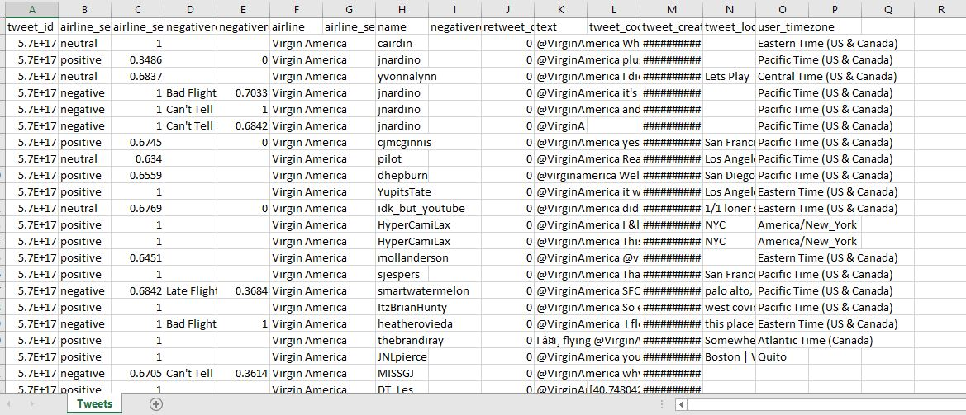
Dataset

Slide 4
Methods Used
Scrapped the data set from Kaggle
Data cleansing and pre-processing
Scrapping the recent tweets from twitter
Applying sentiment analysis on recent tweets
Compare different airlines
Compare the improvements of service of different airlines
Find top words in +ve and –ve tweets

Slide 5

Suggestions

